Slide 1
Steepest Descent and Least-Mean-Square (LMS) Adaptive Filters
Jesper Rindom Jensen, jrj@es.aau.dk
Advanced Signal Processing, Electronic Systems, Aalborg University

Slide 2
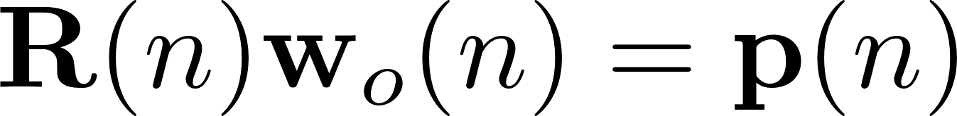
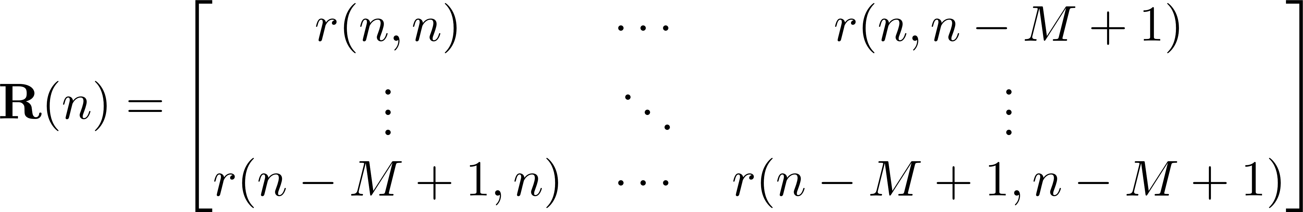
Why Adaptive Filtering?
Imagine that u(n) and d(n) are not jointly stationary → the optimal filter weights are time-varying...

Slide 3
Why Adaptive Filtering?
Two issues...
High computational complexity
Statistics might be unknown
Adaptive filtering can solve these issues!

Slide 4
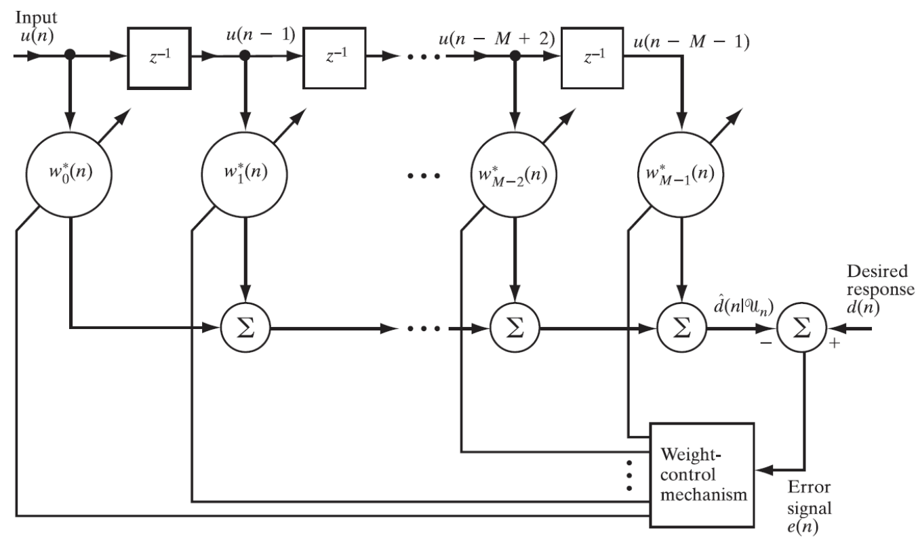
Why Adaptive Filtering?
Adaptive FIR filtering

Slide 5
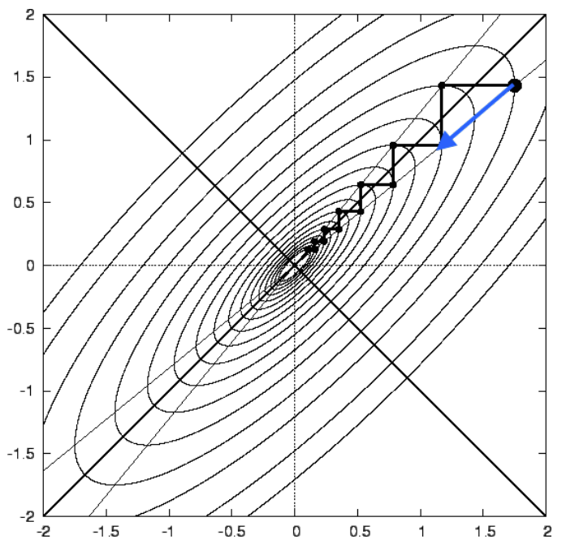
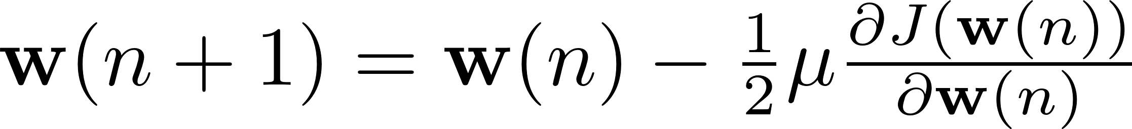
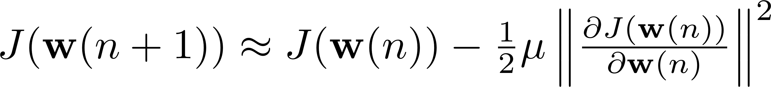
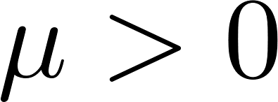
Steepest Descent
Steepest descent: recursive method that allows us the iterative estimation of a filter ➔ tracking of time variations in signal’s statistics.
Steepest descent, when applied to Wiener filtering, converges to the Wiener optimal solution in stationary scenarios.
Step-size parameter

Slide 6
Steepest Descent
Application of steepest descent to Wiener filtering
Now, the filter weights are time-dependent:
And combining the above with the steepest-descent expression...

Slide 7
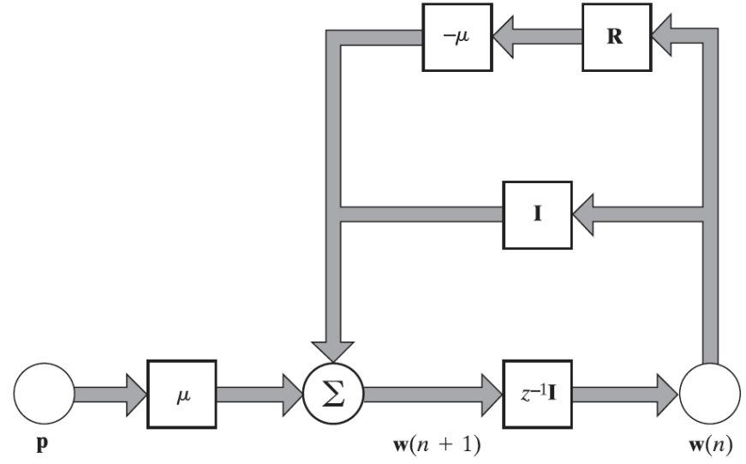
Steepest Descent
Convergence/stability of steepest descent depends on...
...the step-size parameter µ
...the correlation matrix R

Slide 8
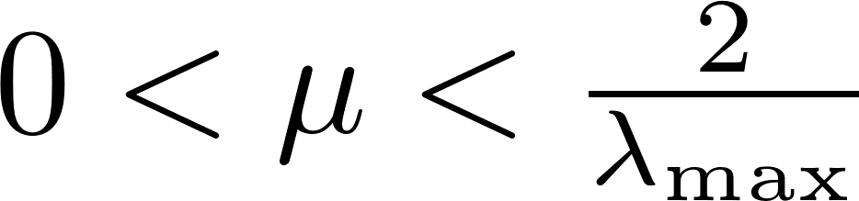
Steepest Descent
A necessary and sufficient condition for the convergence/stability of steepest descent is
λ_{max} the largest eigenvalue of R

Slide 9
Stochastic Gradient Descent
In real-world applications, normally, the statistics R and p are unavailable
We then need different adaptive filtering methods to track time variations in signal’s statistics in an online manner:
Least-mean-square (LMS) algorithm
Recursive least-squares (RLS) algorithm
LMS is based on stochastic gradient descent (SGD)

Slide 10
Least-Mean-Square Adaptive Filters
Some characteristics of LMS adaptive filtering:
Computational complexity linear with the order of the FIR filter
Knowledge on signal’s statistics is not required
LMS is robust against environmental noise/interference
Unlike RLS, LMS does not require the inversion of the correlation matrix of the regressor

Slide 11
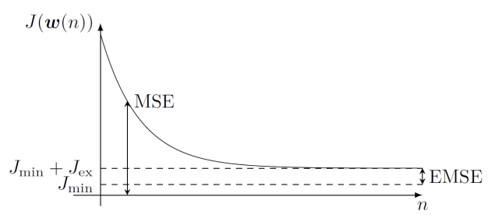
Least-Mean-Square Adaptive Filters
LMS (stochastic gradient descent, SGD) versus steepest descent (SD)
In SD (SGD), the statistics are known (not known), so the gradient and filter weights are deterministic functions (stochastic processes)
As a result, SGD is easier to implement in practice than SD
SGD is an approximation to SD
SD is optimal: it approaches to the Wiener solution as n → +∞
LMS is suboptimal: it randomly walks around the Wiener solution (gradient noise)

Slide 12
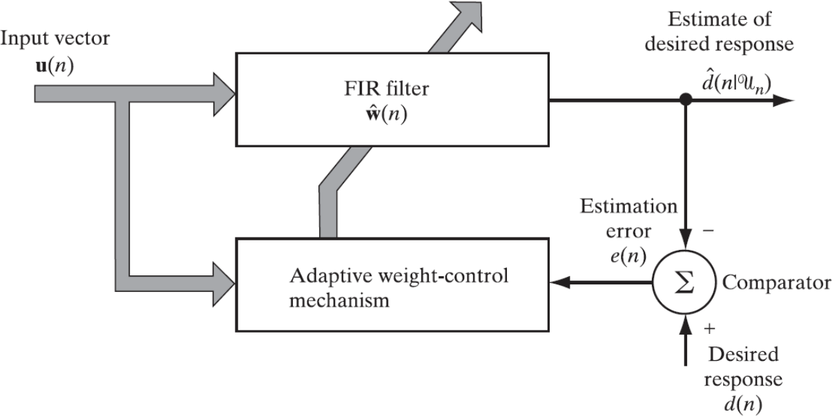
Least-Mean-Square Adaptive Filters
Overall block diagram of an (LMS) adaptive filter:

Slide 13
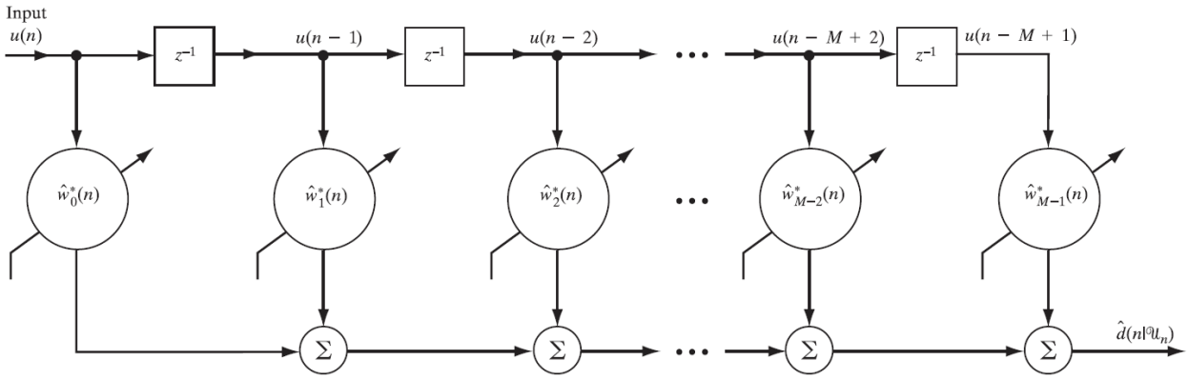
Least-Mean-Square Adaptive Filters
FIR filter:

Slide 14
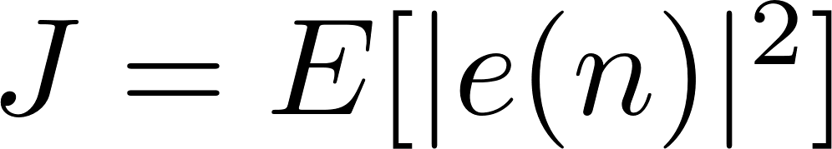
Least-Mean-Square Adaptive Filters
Reminder for Wiener filtering:
Adaptation based on the instantaneous error signal e(n) → stochastic gradient descent: we get rid of the expectation operator
LMS updating rule:
Sample value of a stochastic process

Slide 15
Least-Mean-Square Adaptive Filters
LMS in vector form:
LMS updating rule:

Slide 16
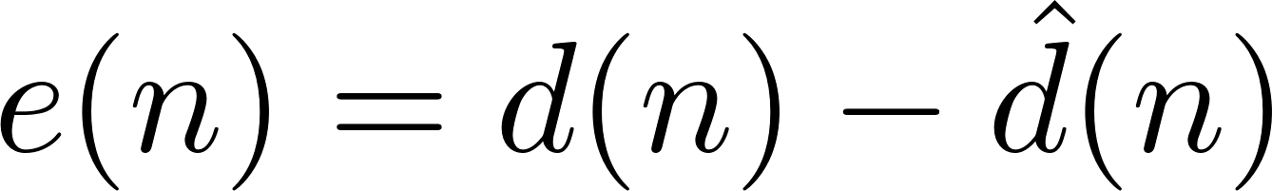
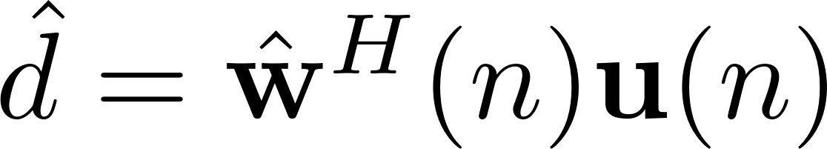
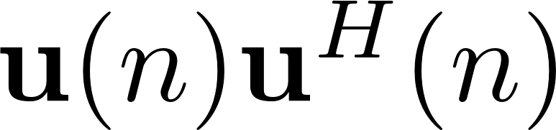
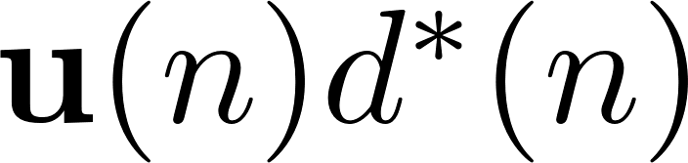
Least-Mean-Square Adaptive Filters
Furthermore, bear in mind that...
We can reach the same solution from steepest descent:
Instead of R:
Instead of p:
LMS feedback: the instantaneous estimates of R and p are averaged over time during adaptation

Slide 17
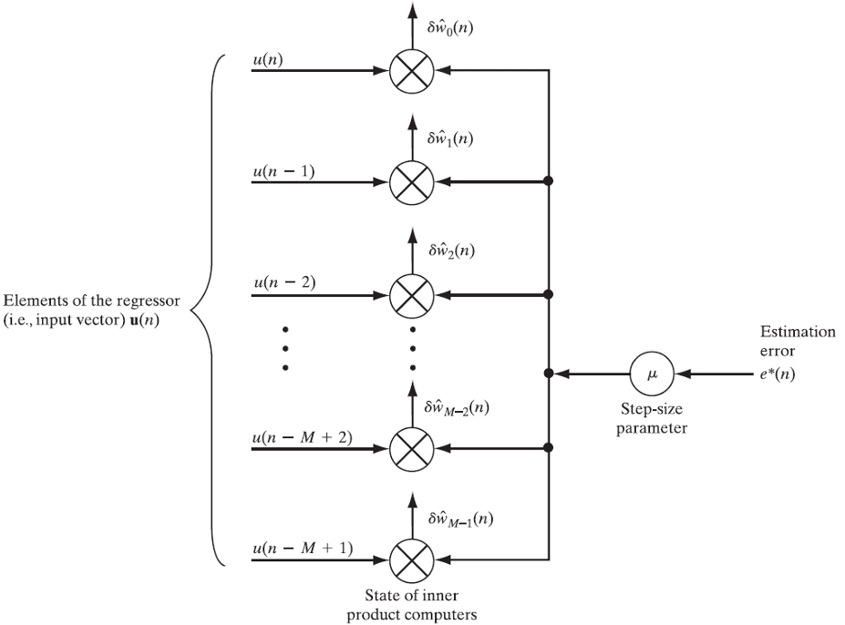
Least-Mean-Square Adaptive Filters
Adaptive weight- control mechanism of LMS:

Slide 18

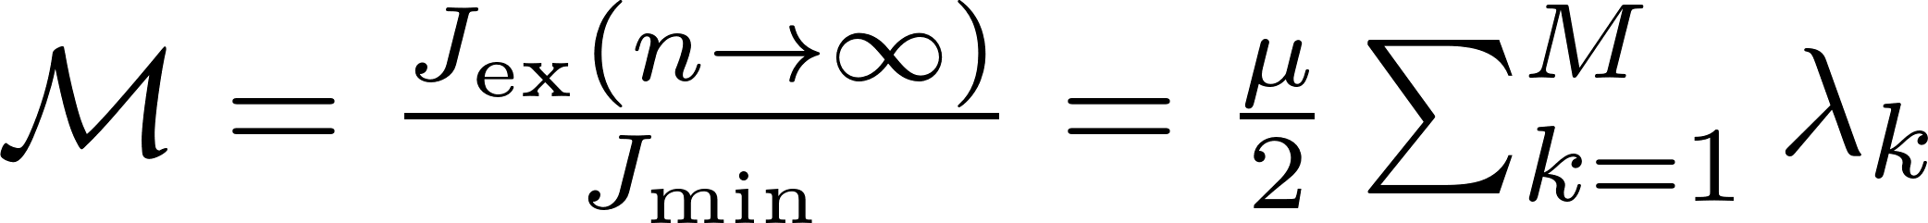
Least-Mean-Square Adaptive Filters
As for steepest descent, convergence/stability of LMS is guaranteed when
In practice, µ has to be sufficiently small for a robust behavior
The excess mean-square error is defined as J_{ex}(n) = J(n) - J_{min}(n)
Misadjustment:
We can give a power interpretation to the above equation

Slide 19
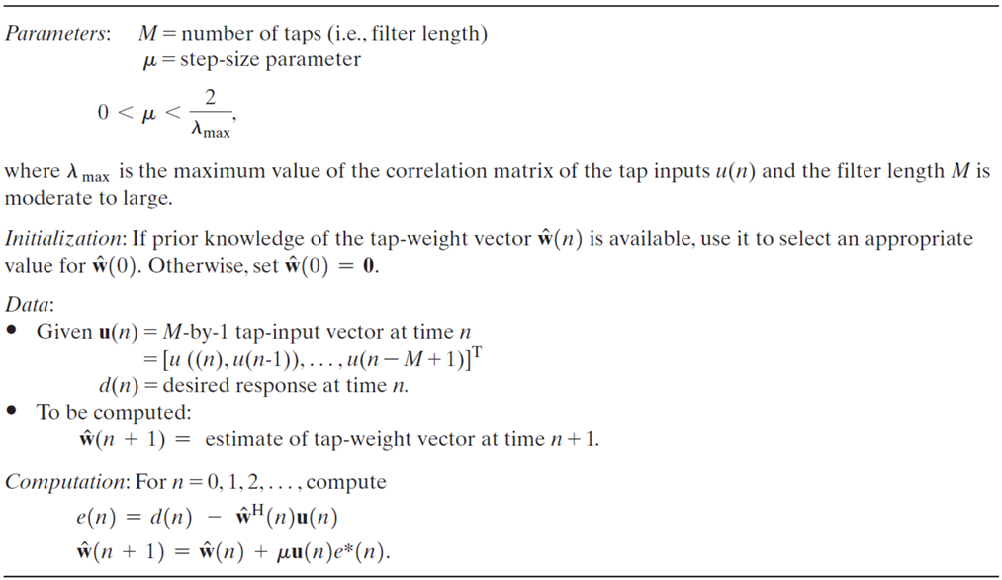
Summary of the LMS algorithm

Slide 20

Normalized LMS
In LMS, when u(n) is large, the adjustment is also large → gradient noise amplification problem
Solution: employing normalized least-mean-square (NLMS) adaptive filters
Normalization factor
NLMS has the same structure as LMS

Slide 21
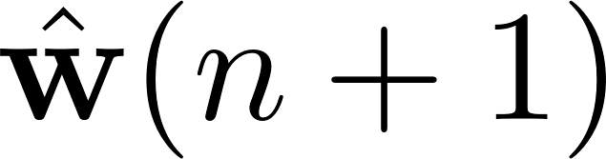
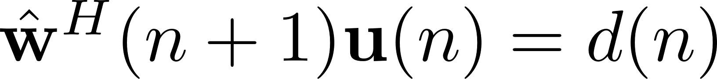
Normalized LMS
Principle of minimal disturbance
Normalized LMS: estimate minimizing
subject to the constraint
We solve it by Lagrange Multipliers:

Slide 22
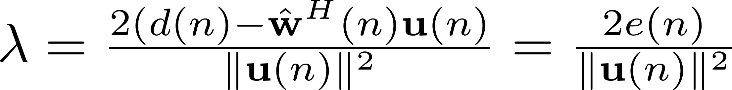
Normalized LMS
Solving Lagrange Multipliers:
And the constraint…
NLMS updating rule:

Slide 23
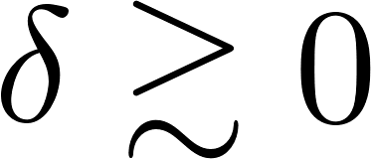
LMS vs. Normalized LMS
NLMS is equivalent to LMS with a time-varying step-size parameter
NLMS has a rate of convergence potentially faster than that of LMS
To avoid numerical instability in NLMS, we introduce as in

Slide 24
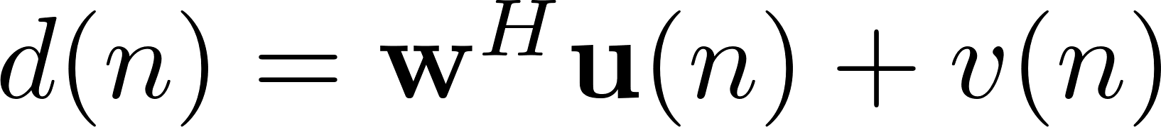
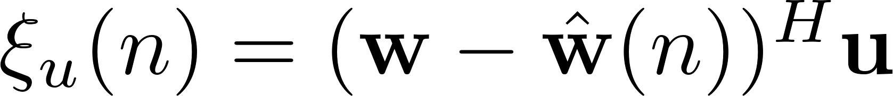
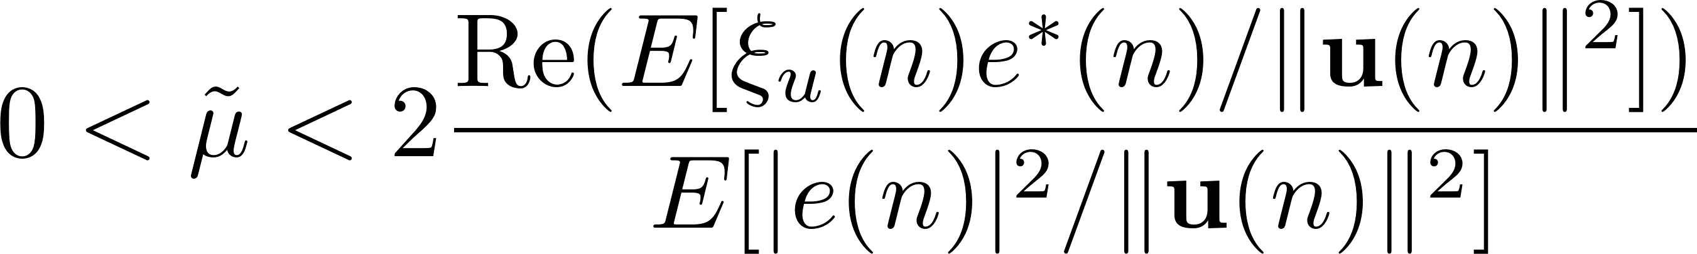
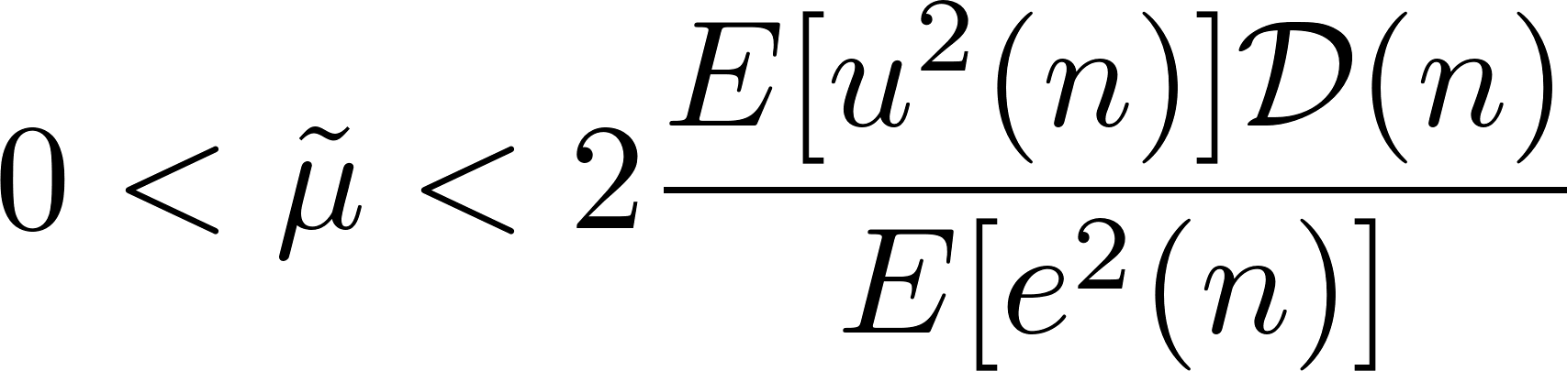
Normalized LMS
Defining some quantities...
Convergence/stability of NLMS is guaranteed if
And, for real-valued data...
Undisturbed error signal

Slide 25
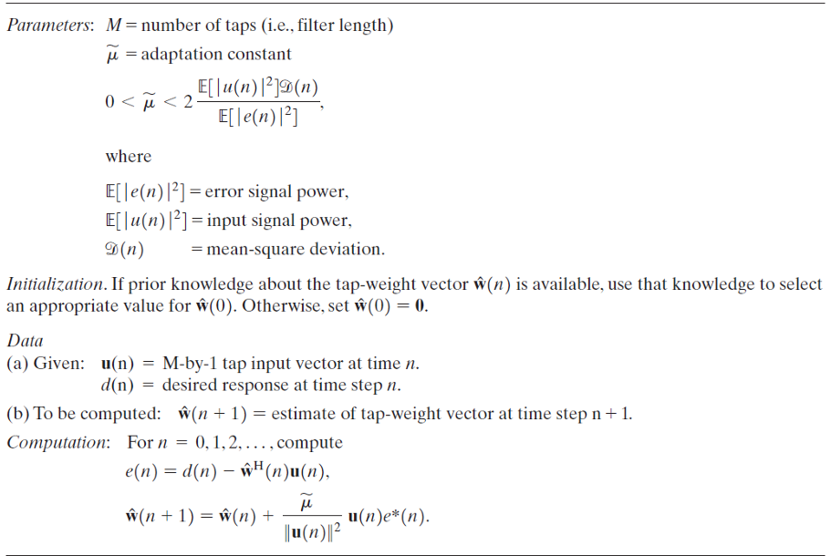
Summary of the NLMS algorithm

Slide 26
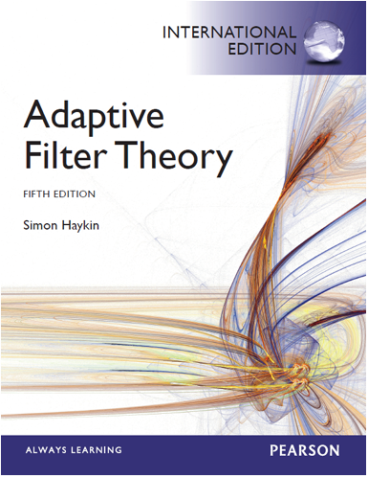
Bibliography
Simon Haykin, “Adaptive Filter Theory (5th Edition)”. Pearson, 2014
Steepest Descent: 4.1, 4.2 and 4.3
Stochastic Gradient Descent: 5.1
Least-Mean-Square Adaptive Filters: 5.2, 6.1, 6.2, 6.4 and 6.5
Normalized LMS: 7.1, 7.2 and 7.3

Slide 27
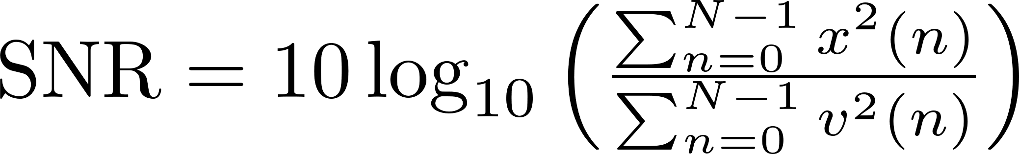
Assignment: Echo Cancellation
We observe a primary signal d(n) (‘signal.asc’) that consists of a local signal (‘local.asc’, theoretically unknown) mixed with an interference. This interference consists of an echo, which is a hybrid-circuit-filtered version of a remote signal u(n) (‘remota.asc’). The sampling rate of these signals is 8 kHz. We want to design a normalized LMS filter canceling such an echo.
1. Draw the block diagram of the system
2. What is the a priori signal-to-noise ratio (SNR) of the observed primary signal d(n)? If y(n) = x(n) + v(n) is a noisy signal, where x(n) and v(n) are the target and noise signals, respectively, recall that the sample SNR is computed as

Slide 28
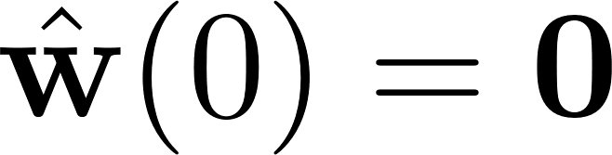

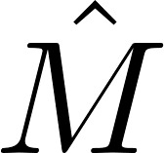

Assignment: Echo Cancellation
3. Implement an echo canceler using NLMS, where . Search for the step-size parameter and filter order maximizing the SNR of the signal after echo cancellation. The search ranges are ∈{0.0001, 0.0002, 0.0004, ..., 0.0512} and M ∈ {1, 2, 3, ..., 10}. What are the SNR, and values?
4. Plot the time evolution of the filter weights for the best SNR configuration. Also, plot both d(n) and the signal after echo cancellation. Very briefly, comment the results
5. Repeat 3) and 4) by assuming that a double talk detector (DTD) spots local speech from sample 2,200, in such a manner that the filter adapts up to that sample only. Compare the results with those obtained in 3) and 4). What kind of filter is obtained upon sample 2,200?

